Slide 1
FRAUD DETECTION SYSTEM
PRANAV.R:-240701394
ABDUL MAJEED.A:-240701004

Slide 2
ABSTRACT
The Fraud Detection System is designed to identify and prevent fraudulent activities by analyzing user behaviour and transaction patterns.In today’s digital world ,fraud has become a significant concern across various domains such as banking,e-commerce,and online payments.This system leverages data analytics,machine learning algorithms,and pattern recognition techniques to detect anomalies that deviate from normal user behaviour.By continuously monitoring transactions and flagging suspicious activities in real-time,the system minimizes financial losses and enhances security.The model can be trained using historical data to distinguish between legitimate and fraudulent activities,ensuring higher accuracy and reliability.The proposed system not only automates the fraud detection process but also helps organizations make informed decisions, ultimately building user trust and maintaining the integrity of digital systems.

Slide 3
INTRODUCTION
In the era of rapid digital transformation, online transactions and digital payments have become an integral part of everyday life. However, with the increasing reliance on digital platforms, the risk of fraudulent activities has also risen significantly. Fraudulent transactions can cause severe financial losses to individuals and organizations, as well as damage their credibility and trust. Therefore, the need for an effective Fraud Detection System has become more crucial than ever.
A Fraud Detection System is designed to automatically identify suspicious activities or anomalies within a large set of transactions. It uses techniques from data mining, machine learning, and statistical analysis to detect patterns that indicate potential fraud. By analyzing user behavior, transaction history, and real-time data, the system can differentiate between legitimate and fraudulent actions.
The main goal of this project is to develop a reliable and efficient system that can prevent fraud before it occurs. The system continuously monitors transactions, learns from previous data, and flags unusual behavior for further verification. Such an approach not only enhances security but also reduces manual effort and operational costs.
This project aims to contribute to safer digital environments by integrating intelligent decision-making methods into fraud prevention processes, ensuring transparency and trust in online transactions.

Slide 4
EXISTING SYSTEM
In the existing system,fraud detection is often carried out using traditional and rule-based approaches.These systems rely on predefined rules,thresholds,or conditions to identify suspicious transactions.For example, a transaction may be flagged if the amount exceeds a certain limit or if it occurs in an unusual location.While this method works for detecting simple cases,it is ineffective in handling complex and evolved fraud patterns.
Most existing systems require manual intervention and periodic rule updates,which make them time-consuming and prone to human error.They are not adaptive to new types of fraudulent behaviour and often result in a large number of negatives,where legitimate transactions are incorrectly marked as fraudulent.Furthermore, these systems lack capability to learn from historical data,limiting their accuracy and efficiency in real-time detection.
Due to the rapid increase in the volume of online transactions and the sophistication of fraudulent techniques, the traditional systems struggle to cope with the scale and complexity of modern fraud. This highlights the need for a more intelligent, automated, and data-driven approach that can dynamically analyze transaction patterns and accurately detect potential frauds.

Slide 5
PROPOSED SYSTEM
The Proposed Fraud Detection System aims to overcome the limitations of traditional rule-based methods by integrating machine learning, data analytics, and pattern recognition techniques to detect fraudulent activities more accurately and efficiently. Instead of relying on static rules, the proposed system uses intelligent algorithms that learn from historical transaction data and continuously improve their detection capabilities.
The system analyzes multiple parameters such as transaction amount, frequency, location, user behavior, and device information to identify abnormal patterns that may indicate fraud. When suspicious activities are detected, the system generates alerts for further verification or automatically blocks the transaction to prevent potential loss. This approach ensures real-time monitoring and faster response to emerging threats.
Additionally, the proposed system provides a user-friendly interface for administrators to view reports, monitor system performance, and update datasets. By leveraging predictive modeling and classification techniques such as logistic regression, decision trees, or neural networks, the system achieves higher accuracy and minimizes false alarms.
Overall, the proposed system enhances security, reduces manual workload, and improves the reliability of fraud detection. It provides a scalable and adaptive solution capable of handling large transaction volumes and evolving fraud strategies, ensuring safer and more trustworthy digital transactions.

Slide 6
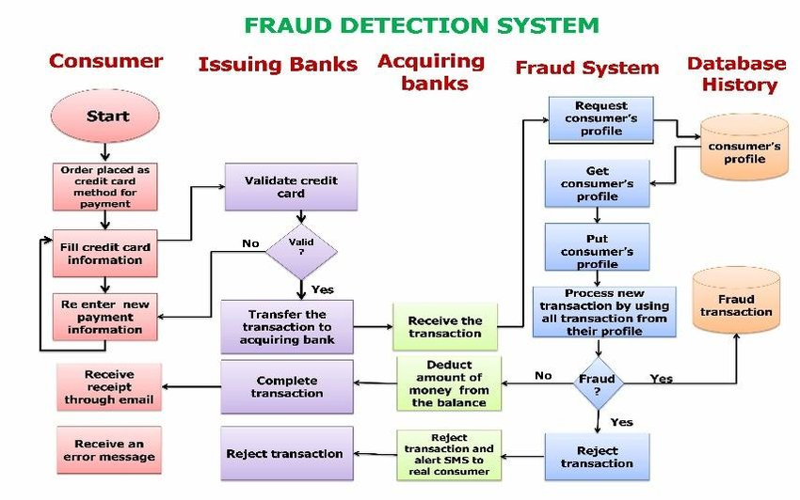
ARCHITECTURE DIAGRAM

Slide 7
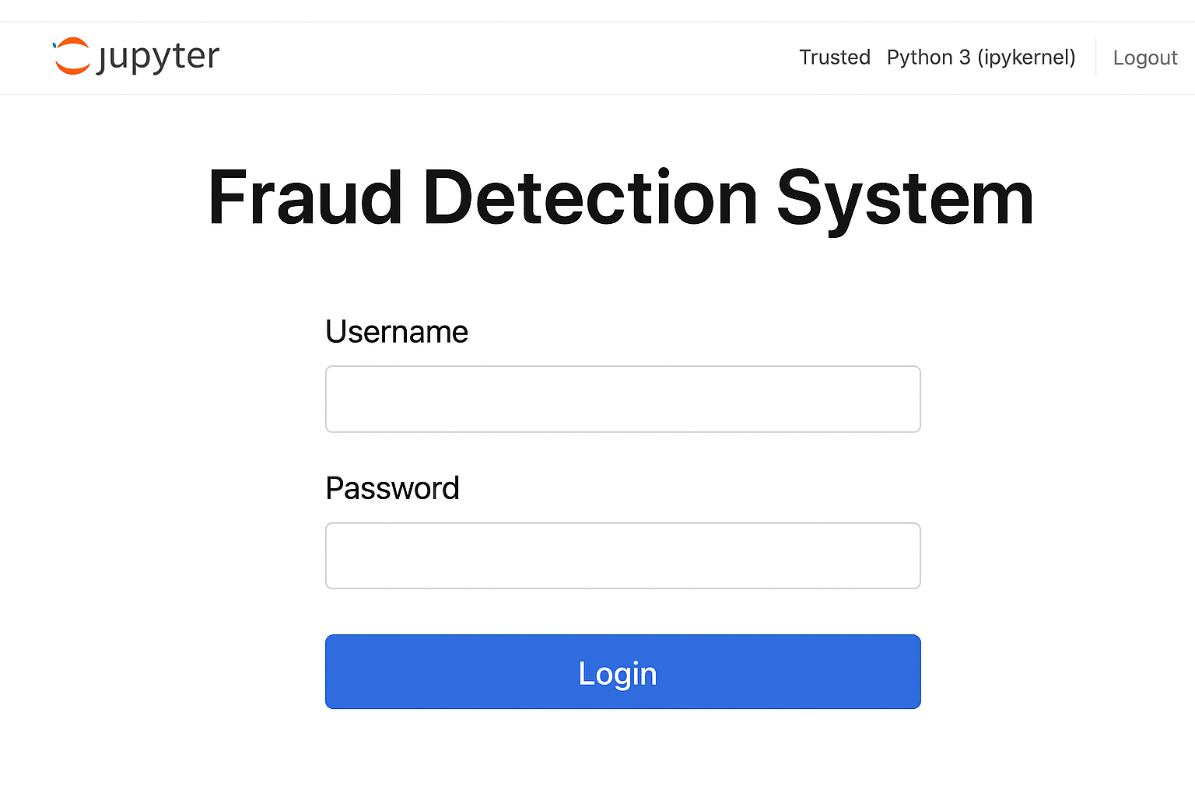
OUTPUT WITH SCREENSHOTS

Slide 8
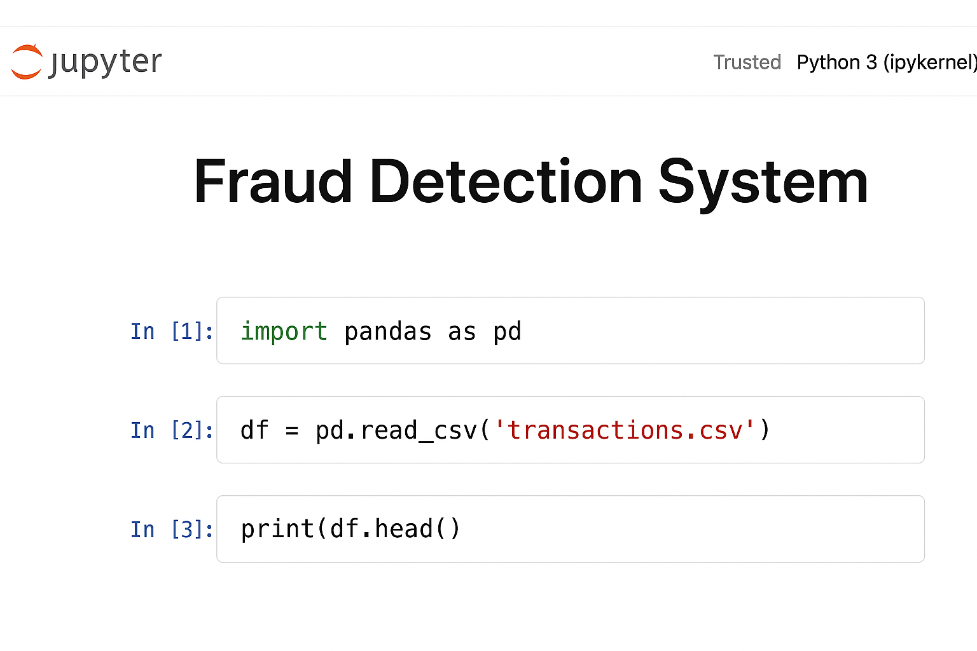

Slide 9
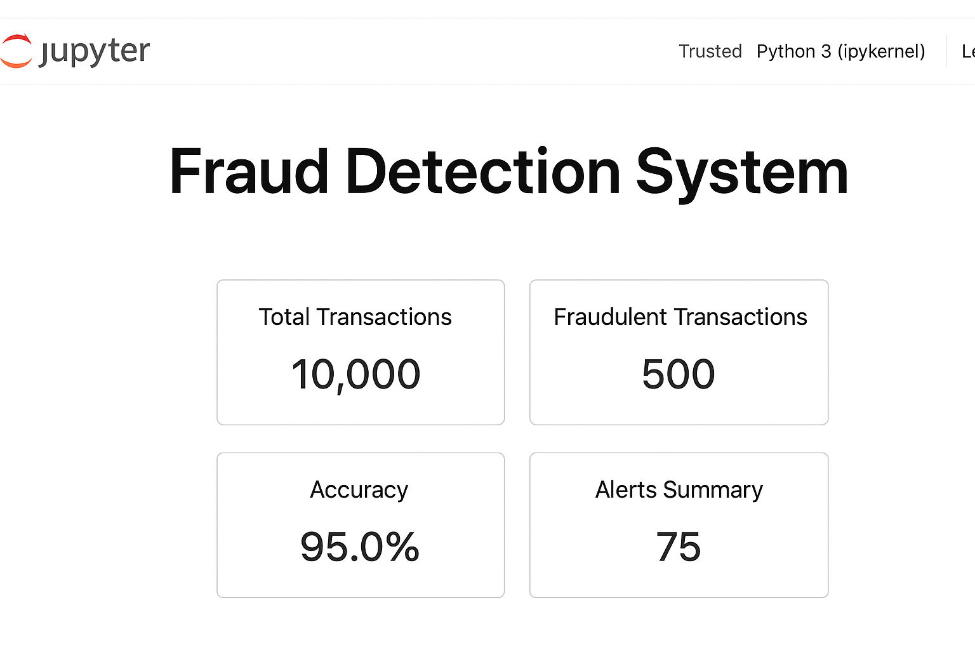

Slide 10
CONCLUSION
The Fraud Detection System plays a crucial role in safeguarding digital transactions and maintaining the integrity of online financial systems. Through the use of machine learning algorithms, data analysis, and pattern recognition techniques, the system effectively identifies and prevents fraudulent activities by analyzing user behavior and transaction patterns.
The implementation of this project demonstrates how technology can be leveraged to detect anomalies in real time and significantly reduce manual intervention. By learning from historical data, the model can adapt to evolving fraud patterns, offering improved accuracy and reliability over traditional rule-based methods.
Overall, the system enhances security, builds user trust, and supports organizations in minimizing financial losses. In the future, the model can be further improved by integrating deep learning techniques, real-time data streaming, and AI-based predictive analytics to create even more robust and scalable fraud detection solutions.

Slide 11
REFERENCES
Kaggle – Credit Card Fraud Detection Dataset https://www.kaggle.com/datasets/mlg-ulb/creditcardfraud
Towards Data Science – Building a Fraud Detection Model https://towardsdatascience.com/fraud-detection-using-machine-learning-5e2f3e8a8c2f
IBM Developer – Fraud Detection Techniques https://developer.ibm.com/articles/credit-card-fraud-detection-using-machine-learning/
GeeksforGeeks – Fraud Detection using Python https://www.geeksforgeeks.org/fraud-detection-using-machine-learning/

